Slide 1
RISK MANAGEMENT
MODULE 4

Slide 2
RISK
A Risk is an uncertain event or condition that
occurs in a project
which has positive or negative
effect on the overall project objectives.
As per PRINCE2 - UK government-sponsored project management standard, “risk is a chance of exposure to the adverse consequences of future events”.

Slide 3
Risk Definition
Project plans have to be based on assumptions
Risk is the
possibility that an assumption is wrong
When the risk happens it becomes
a problem or an issue
Risks relate to possible future problems, not current ones They involve a possible cause and its effect(s)
e.g. developer leaves ---> task delayed
After identifying the possible risks, actions are taken to eliminate the risks

Slide 4
Risk Management
Risk Management is an important part of project planning activities. It involves identifying and estimating the probability of risks with their order of impact on the project.
1.Risk Identification:
Risk identification involves brainstorming activities. Brainstorming is a group discussion technique where all the stakeholders meet together. This technique produces new ideas and promotes creative thinking.
Preparation of risk list involves identification of risks that are occurring continuously in previous software projects.

Slide 5
Risk Analysis and Prioritization:
Identifying the problems causing risk in projects
Identifying the probability of occurrence of problem
Identifying the impact of problem
Calculate the risk exposure factor
Prepare a table consisting of all the values and order risk on the basis of risk exposure factor

Slide 6
Risk Avoidance and Mitigation:
To eliminate the occurrence of risks.
So, the method to avoid risks is to reduce the scope of projects by removing non-essential requirements.
Risk Monitoring:
The risk is monitored continuously by reevaluating the risks, the
impact of risk, and the probability of occurrence of the risk.
This ensures that:
Risk has been reduced
New risks are discovered
Impact and magnitude of risk are measured

Slide 7
Risk Categorization
Project risks /Schedule risks
They threaten the project plan
If they become real, it is likely that the project schedule will slip and that costs will increase (affect company’s economy)
Schedules often slip due to the following reasons:
Incorrect time estimation.
Resources are not tracked properly (resources like staff, systems, skills of individuals, etc).
Failure to identify complex functionalities and time required to develop those functionalities.
Unexpected project scope expansions.
(More on next slide)
7

Slide 8
Technical risks
Technical risks generally lead to failure of functionality
and performance
They threaten the quality and timeliness of the software to be produced
If they become real, implementation may become difficult
or impossible
Causes of Technical Risks are:
Continuously changing requirements
Lack of availability of advanced technology
The product is complex to implement.

Slide 9
Operational Risks
Risk of loss due to
improper process implementation, failed
system or some external event risks
.
Causes of Operational Risks:
Insufficient resources
Failure to resolve responsibilities.
Failure to address priority conflicts
No proper subject training, resource planning
Lack of communication within the team.

Slide 10
Business risks
They threaten the viability of the software to be built
If they become real, they jeopardize (place at risk) the project or the product

Slide 11
Sub-categories of Business risks
Market risk – building an excellent product or system
that no
one really wants
Strategic risk – building a product that
no longer fits into the
overall business strategy
for the company
Sales risk – building a product that the sales force
doesn't
understand how to sell
Management risk – loosing the support of senior management due to a change in focus or a change in people
Budget risk – loosing budgetary or personnel commitment
Wrong budget estimation.
Cost overruns, Project scope expansion
11

Slide 12
Risk Categorization – Approach #2
Known risks
Those risks that can be uncovered after careful evaluation of
the project plan, the in
business and technical environment
which the project is being developed, and other reliable information sources (e.g., unrealistic delivery date, losing 10% of their customers to a new competitor)
Predictable risks
Those risks that are extrapolated from past project experience (e.g., past turnover)
Unpredictable risks
Those risks that can and do occur, but are extremely difficult to identify in advance eg. Severity of fall in market
12

Slide 13
Risk Management approaches: Reactive vs. Proactive Risk Strategies
Reactive risk strategies
"Don't worry, I'll think of something"
The majority of software teams and managers rely on this approach
Nothing is done about risks until something goes wrong
The team then flies into action in an attempt to correct the problem rapidly (fire fighting)
Crisis management is the choice of management techniques
Proactive risk strategies
The proactive approaches try to anticipate the possible risks that the
project is susceptible to.
(Primary objective is to avoid risk and to have a contingency plan in place to handle unavoidable risks in a controlled and effective manner)

Slide 14
Steps
Identify possible risks; recognize what can go wrong
Analyze each risk to estimate the probability that it will occur and the impact (i.e., damage) that it will do if it does occur
Rank the risks by probability and impact
- Impact may be negligible, marginal, critical, and catastrophic
Develop a contingency plan to manage those risks having high probability and high impact

Slide 15
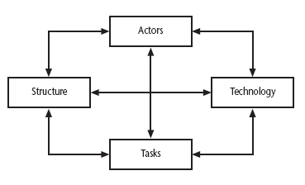
Sociotechnical Model of Risk Categorization
How any technology is used and produced?
Lyytinen – Mathiassen – Ropponen risk framework

Slide 16
Actors relate to all those involved in the project development
including developers, users and managers
Risk could be that leads to information of
high staff turnover
importance to the project being lost.
Technology – covers both the technology used to implement the application and that embedded in the project deliverables.
Risk could be that the
technologies selected are not in fact
appropriate.

Slide 17
Structure – this includes management procedures such as planning and control.
Risk here is that
a group who need to carry out a particular project
task are not informed of this need
because they are not part of the
project communication network.
Tasks – the work to be carried out.
A typical risk is that the amount of effort needed to carry out the
task is
under estimated.
A risk could belong to more than one of the four areas – for example, estimates being wrong could be influenced by problems with actors (e.g. lack of experience with a technical domain) or the structure (over optimism of managers keen to win work).

Slide 18
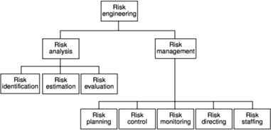
Barry Boehm’s Risk Engineering
Task breakdown structure

Slide 19
A framework for dealing with risk
The planning for risk includes these steps(Barry Boehm):
1. Risk identification – what risks might there be? Eg. what are the risks to a project?
Approaches to identifying risks include:
Use of checklists – usually based on the
experience of past
projects.
◦
Suggests potential countermeasures
Brainstorming – getting
knowledgeable stakeholders
together to
pool concerns

Slide 20
Risk Identification: Boehm’s top 10 Software development risks
Table: Software project risks & strategies for risk reduction
Risk | Risk reduction techniques
Personnel shortfalls | Staffing with top talent; job matching; teambuilding; training and career development; early scheduling of key personnel
Unrealistic time and cost estimates | Multiple estimation techniques; design to cost; incremental development; recording and analysis of past projects; standardization of methods
Developing wrong software functions | Improved software evaluation; formal specification methods; user surveys; prototyping; early user manuals
Developing wrong user interface | Prototyping; task analysis; user involvement
21

Slide 21
Boehm’s top ten risk - continued
Gold plating - inclusion of features that in fact are unnecessary and which end up never actually being used | Requirements scrubbing, prototyping, design to cost
Late changes to requirements | Change control, incremental development
Shortfalls in externally supplied components | Benchmarking, inspections, formal specifications, contractual agreements, quality controls
Shortfalls in externally performed tasks | Quality assurance procedures, competitive design, etc
Real time performance problems | Simulation, prototyping, tuning
Development technically too difficult | Technical analysis, cost-benefit analysis, prototyping , training
22

Slide 22
Factors to consider in risk identification
Staff Factors
Project Factors / Method Hardware and Software Factors Change Factors
Supplier Factors Application Factors Environmental Factors Health and Safety Factors

Slide 23
Risk assessment/analysis and prioritization – which are the most serious risks?
Eg. a high-risk event could be a
data breach or the loss of
critical operations.
A low-level risk might be a minor budget overrun. Regardless of specific prioritization approach, the idea is to rank from low risk to high risk.
Risk planning – what are we going to do about them?
Risk monitoring – what is the current state of the risk? Has the planning worked?

Slide 24
Risk Assessment & Prioritization
- A way to distinguish the damage and likely risks
Risk exposure (RE) = (potential damage) x (probability of occurrence)
Quantitative approach
Ideally,
Potential damage: is assessed as a money value e.g. data
centre vulnerable to Fire to configure new data centre
requiring Rs.5,00,000
Probability Chance of 1 in 1000 for fire actually happening ; hence probability of 0.001
RE = Rs.500000 x 0.001 = Rs.500
25

Slide 25
To understand this value as a minimum sum an insurance company would require as a premium,
and if all in same position contribute
100 companies
Rs.5000 to a fund
, then, when 1 in 1000 chance of the
fire actually occurred, there could be enough money to cover the cost of recovery.
i.e., 100*5000 = 500000

Slide 26
Eg. Assume a flood would cause a damage of 5Lakhs and
if 0.01 (one in hundred chance) is the probability of occurrence
RE = 5 Lakhs x 0.01 = Rs.5000
Crudely analogous to the amount needed for an insurance premium. If there were 100 people chipping in 5000 each, there would be enough for 1 in 100 chance of the flooding.
If there were 2 floods then the system collapses!
With project risks, these quantitative approaches are usually
impractical
and more qualitative approaches are used instead
Note: Probability: 0.00 (absolutely no chance) to 1.00 (absolutely
certain)

Slide 27
Amanda’s risk exposure assessment: Relative scaling in prioritizing
 | Hazard | Likelihood (0-10 scale) | Impact(0- 10 scale) | Risk exposure
R1 | Changes to requirement specs during coding | 8 | 8 | 64
R2 | Specification takes longer than expected | 3 | 7 | 21
R3 | Significant staff sickness affecting critical activities | 5 | 7 | 35
R4 | Significant staff sickness affecting non-critical activities | 10 | 3 | 30
R5 | Module coding takes longer than expected | 4 | 5 | 20
R6 | Module testing demonstrates errors of deficiencies in design | 4 | 8 | 32 28

Slide 28
Risk probability: qualitative descriptors and range values
Probability level | Range
High | Greater than 50% chance of happening
Significant | 30-50% chance of happening
Moderate | 10-29% chance of happening
Low | Less than 10% chance of happening
Generally, it would be better to identify
an approximate range
rather than a precise probability.
29

Slide 29
Qualitative descriptors of
impact on cost and
associated range values
Impact level | Range
High | Greater than 30% above budgeted expenditure
Significant | 20 to 29% above budgeted expenditure
Moderate | 10 to 19% above budgeted expenditure
Low | Within 10% of budgeted expenditure.
30

Slide 30
Similar tables can be produced for the impact on project duration and on the quality of project deliverables.
The problem with the qualitative approach is on how
to and
combine the judgements about probability
impact
– we can’t multiply them together.
In such cases, the position of the risk in a matrix is
used to indicate the risk exposure.

Slide 31
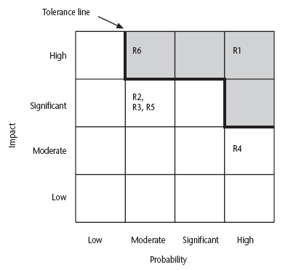
Probability impact matrix/grid or summary risk profiles
R1, R2, etc are risks
Likelihood & impact is reflected in the grid.
Risks falling in high impact zone have a degree of seriousness and require urgent action
32

Slide 32
R1, R2 etc refer to particular risks (See Table 7.4 in the textbook). They are located on the grid according to the likelihood and impact ratings that have been allocated to them.
A zone around the top right hand corner of the grid can be designated and risks falling within that zone are treated as requiring urgent action.

Slide 33
A risk that has a potential damage of $40,000 and a probability of
occurrence of 12% will be given a higher priority than a risk having
a potential damage of $35,000 and a likelihood of 14%. Is it ( True
/ False)
Risk exposure = potential damage * probability of occurrence (likelihood)
Risk exposure for risk1 = 40,000*0.12 = $4800 Risk exposure for risk2 = 35,000*0.14 = $4900 Obviously risk2 should be given higher priority.
FALSE
34

Slide 34
Risk planning
Risk acceptance – do nothing (the cost of avoiding the risk may be greater than the actual cost of the damage that might be inflicted)
Risk avoidance –Avoid risk prone activities. (if you are worried about
crocodiles then don’t go into the water). (avoid the environment in which the risk occurs
Risk reduction – take precautions (the are
risk is accepted but actions
taken to
reduce its likelihood
e.g. prototypes ought to reduce the risk of incorrect
requirements). Attempts to reduce the likelihood of risk occurring.
Risk transfer – risk is transferred to another person or organization. The risk of
incorrect development estimates can be transferred by negotiating a fixed price contract with an outside software supplier.
Risk mitigation/contingency measures- tries to reduce the impact if the risk
does occur e.g. to allow rapid recovery in the case of system
taking backups
crash Action taken to reduce the impact of risk.
35

Slide 35
Risk reduction leverage
Cost effectiveness of a risk reduction action can be assessed by RRL.
Risk Reduction Leverage (RRL) is defined as the difference
between the Risk Exposure before and after the
reduction activity divided by the cost
of that activity.
Risk reduction leverage (RRL) = (RE_{before}- RE_{after}) / (cost of risk reduction)
(RRL > 1), RRL greater than 1 indicates that the
reduction in risk exposure achieved by a measure
is
greater than its cost.
This would, in the long term, be
beneficial.
36

Slide 36
Risk reduction leverage
^{RE}before^{is}
risk exposure before risk reduction
^{RE}after ^{is}
risk exposure after risk reduction
e.g. 1% chance of a fire causing £200k damage.
e.g. installing fire alarm costing £500 reduces probability of fire damage to 0.5%
RRL = (1% of £200k)-(0.5% of £200k)/£500 = 2
RRL > 1.00 therefore its worth doing
W.r.t the analogy to insurance, an insurance company might reduce the
fire insurance premium from £2k to £1k on condition that a fire alarm
is installed. The insured would save £1k a year by investing £500 so it would be worth doing.
37

Slide 37
Seven Principles of Risk Management
Maintain a global perspective
View software risks within the context of a system and the
business problem that is intended to solve
Take a forward-looking view
Think about risks that may arise in the future; establish contingency plans
Encourage open communication
Encourage all stakeholders and users to point out risks at any time
Integrate risk management
Integrate the consideration of risk into the software process
41

Slide 38
Emphasize a continuous process of risk management Modify identified risks as more becomes known and add new risks as better insight is achieved
Develop a shared product vision
A shared vision by all stakeholders facilitates better risk identification and assessment
Encourage teamwork when managing risk
Pool the skills and experience of all stakeholders when conducting risk management activities

Slide 39
Reducing the risks
Hazard prevention Likelihood reduction Risk avoidance
Risk transfer Contingency planning

Slide 40
Causal mapping
Causal mapping is a technique that can be used to visually represent the cause-and-effect relationships between factors that influence a business's performance.
Causal mapping – identifying
possible chains of cause
and effect
It is designed for the analysis and visualization of qualitative data about causal links.

Slide 41
Causal mapping
Causal mapping is a tool that enables you to make sense of challenging situations,
so that you can get more out of them.
A causal map is a word and arrow diagram in which
ideas and actions are
causally linked with one another
through the use of arrows.
Eg. Gather major stakeholders together and brainstorm collectively on what could go wrong.
The causes of the problems identified are
traced back using the mapping
technique which identifies the project factors
( or ‘concept variables’) that people
see as being important and the causal links between them. These links can be positive or negative.
Where possible, for each factor, positive and negative aspects are identified e.g. ‘stable…unstable requirements’.

Slide 42
Causal mapping: is a network diagram representing causes and effects.
50

Slide 43
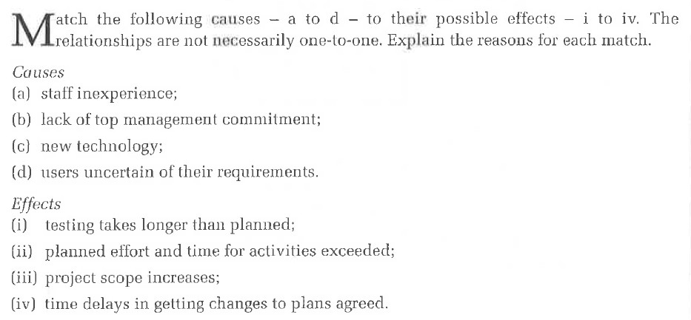

Slide 44
Questionnaire on Project Risk
(Questions are ordered by their relative importance to project success)
Have top software and customer managers formally
committed to support the project?
Are end-users enthusiastically committed to the project and the system/product to be built?
Are requirements fully understood by the software
engineering team and its customers?
Have customers been involved fully in the definition of requirements?
Do end-users have realistic expectations?
Is the project scope stable?
(More on next slide)
52

Slide 45
Questionnaire on Project Risk (continued)
Does the software engineering team have the right mix of
skills?
Are project requirements stable?
Does the project team have experience with the technology to be implemented?
Is the number of people on the project team adequate to do the job?
Do all customer/user constituencies agree on the importance of the project and on the requirements for the system/product to be built?
53

Slide 46
Tutorials
List the major risks that might affect your project (J component) and identify strategies for minimizing each of those risks.
List the top risks that may happen in the highly user friendly web based development project and also provide the risk table for the same.
Identify the various risk tools available online to
demonstrate.

Slide 48
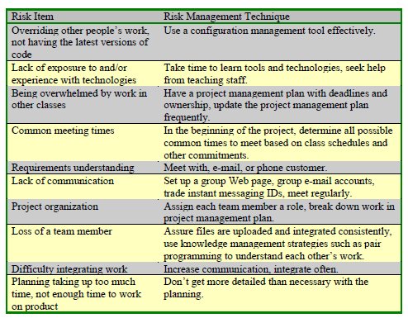
Risk Management in Educational Projects

Slide 49
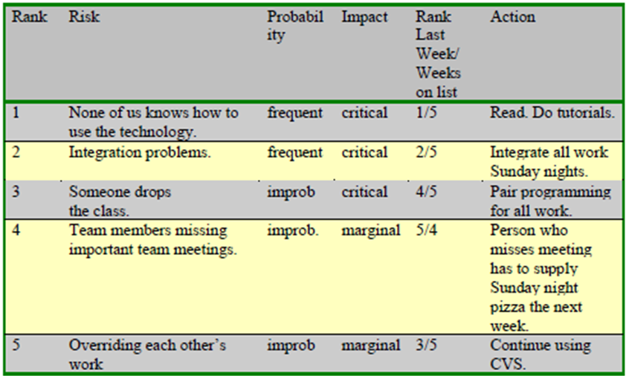
Sample Student Risk Table

Slide 50
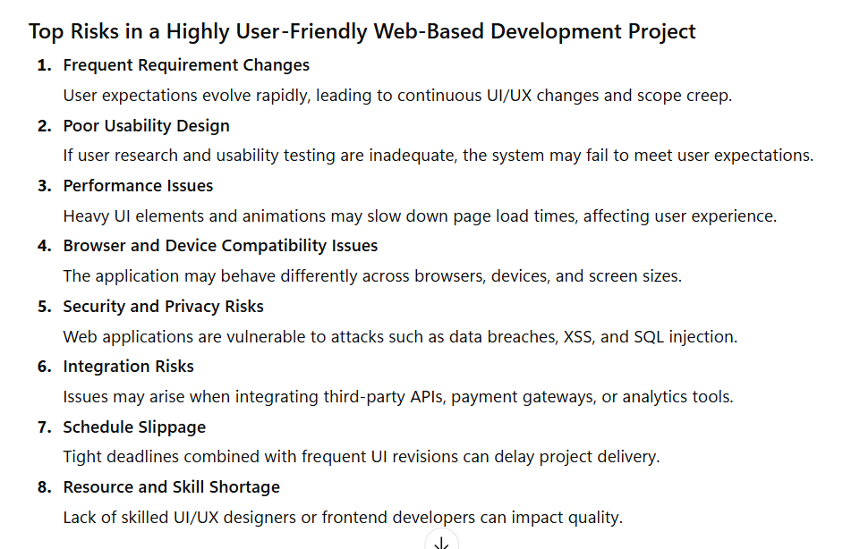

Slide 51
